Slide 1

Software Heritage
Day of the week, Month DDth, Year

Slide 2
Software is everywhere…
Binding our personal and social lives
Embodying a vast part of the technological knowledge that powers our industry
Supports modern research
Mediates access to digital content
Fuels innovation

Slide 3
Software is written by humans
… in the form of software Source Code
and should also
« be written for humans to read »
and « provides a view into the mind of the designer »

Slide 4
Software Heritage is
A long term archive for source code… that…
Simplifies source code distribution
Provides perpetual identifiers
Can be integrated in your compliance process, saving time and resources
Allows you to rely on a mutualised infrastructure

Slide 5

Paris Call
«Software source code represents unique knowledge of humanity’s recent history.
It is therefore crucial to work together collectively so that the knowledge embedded in software source code is properly preserved, valued and sharedwith all.
This lies at the core of UNESCO’s cooperation with Inria to support the creation of Software Heritage, the global archive of software source code»

Slide 6
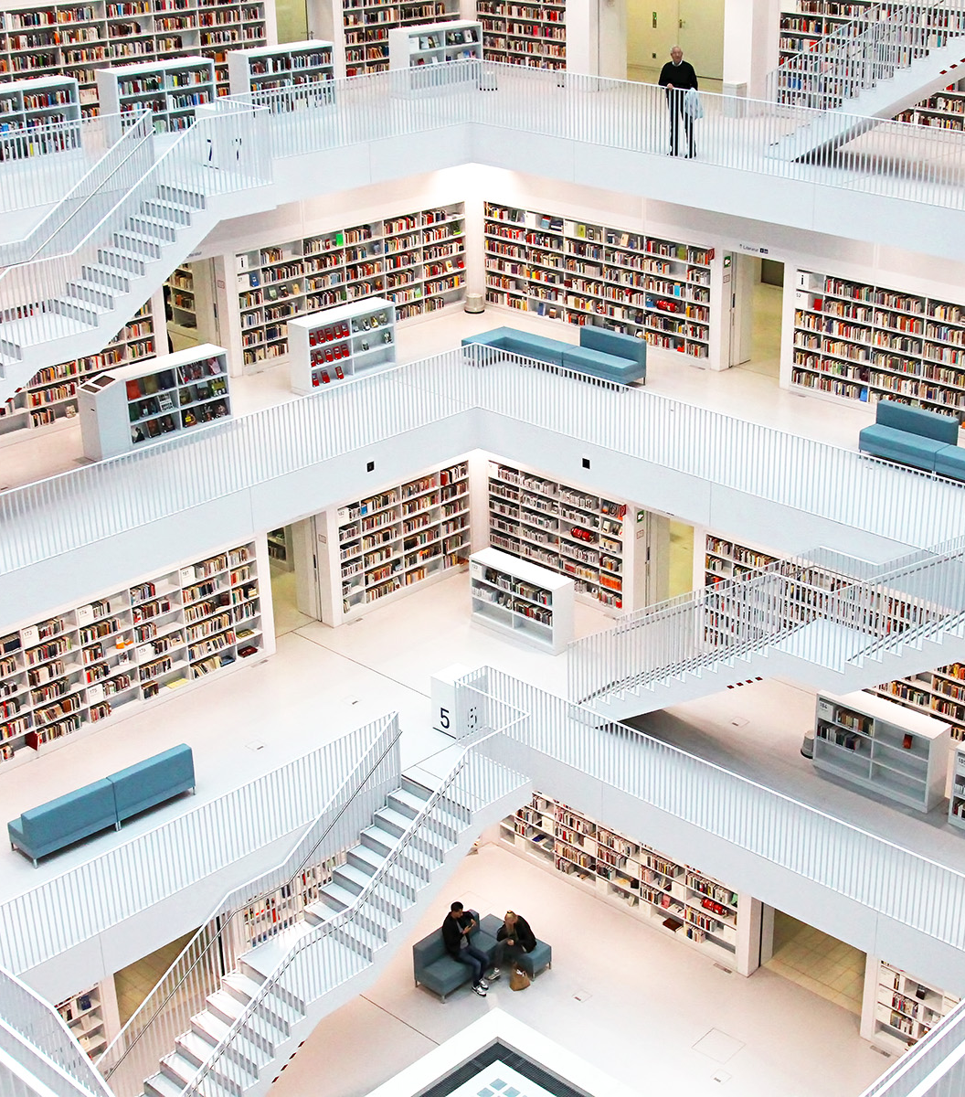
We are building the « Library of Alexandria » of software source code

Slide 7

Building the Software pillar of Open Science, fostering Reproducible Research

Slide 8
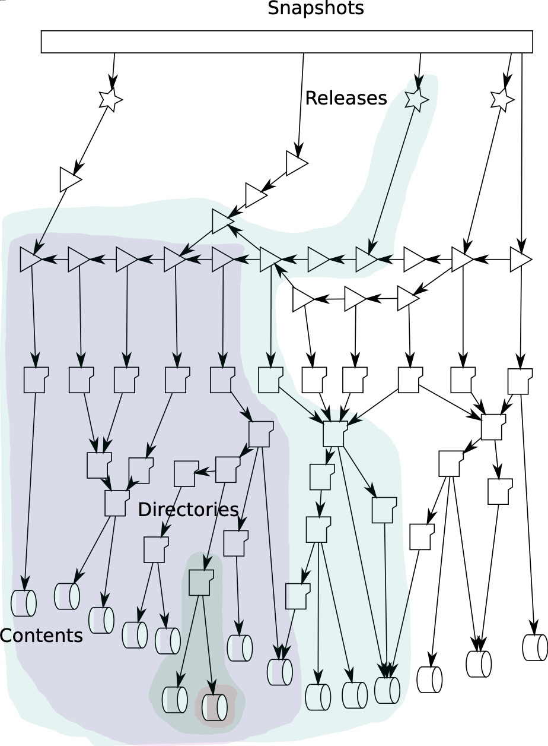
We are building a full graph of software development evolution

Slide 9
Software Heritage Acquisition Process
softwareheritage.org/swhap/

